Slide 1
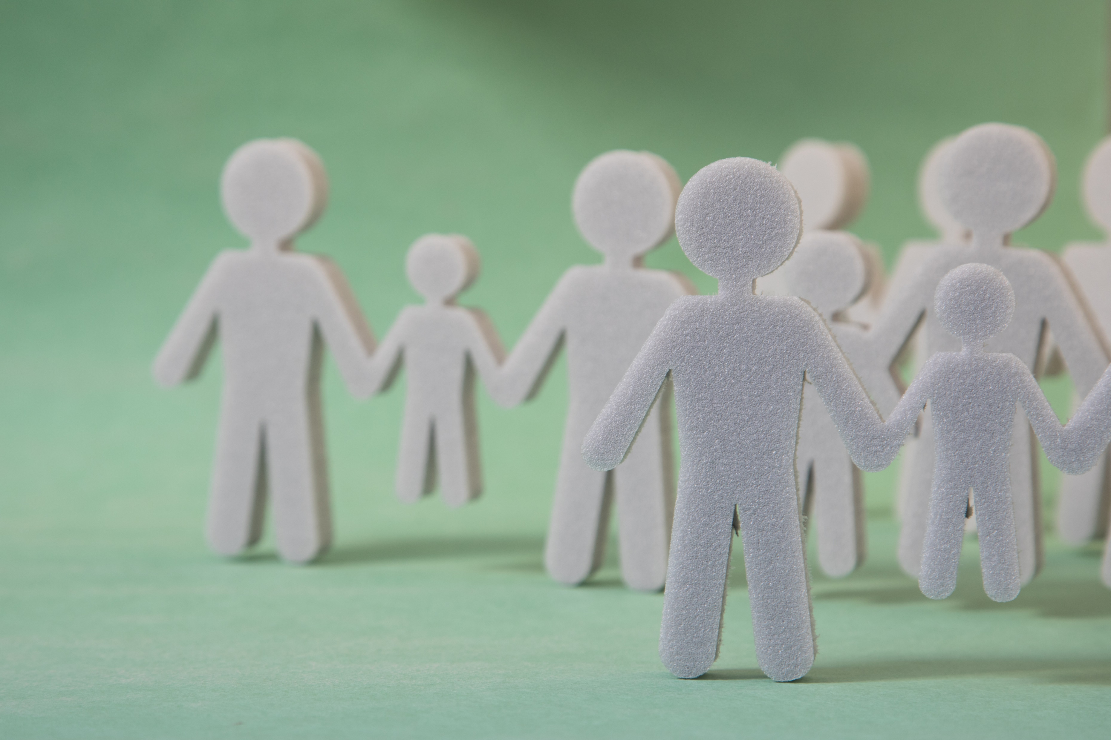
Philippians 1:1-2
Who Am I?
Principles of a Gospel Identity
Preached by Dan Bridges Amman International Church, Jordan (AmmanChurch.org) Uploaded by Dr. Rick Griffith • Jordan Evangelical Theological Seminary Files in many languages for free download at BibleStudyDownloads.org

Slide 2
What questions does your culture ask to establish a person’s identity?
Notes:
For example,
In the US, one of the first questions people tend to ask when they meet someone is, “What do you do?”
In Jordan, one of the first questions people tend to ask when they meet someone is, “What family are you from?”
Discuss in pairs or threes

Slide 3
At the heart, identity is how we think about ourselves… It’s what we put confidence in.
Notes:
For example,
In the US, one of the first questions people tend to ask when they meet someone is, “What do you do?”
In Jordan, one of the first questions people tend to ask when they meet someone is, “What family are you from?”
Discuss in pairs or threes

Slide 4
Factors that can affect our identity…
Passport country
Race
Level of education
Our position or type of job
Who our family is
Married vs Single
Position at church
Notes:
For example,
In the US, one of the first questions people tend to ask when they meet someone is, “What do you do?”
In Jordan, one of the first questions people tend to ask when they meet someone is, “What family are you from?”
Discuss in pairs or threes

Slide 5
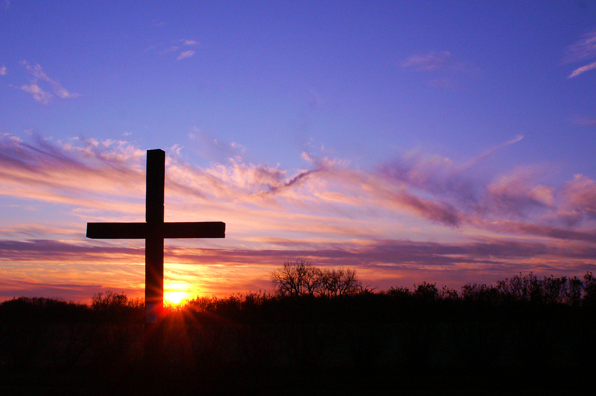
As Believers in Jesus God Gives Us a New Identity!
This is Our “Gospel Identity”
Notes:
For example,
In the US, one of the first questions people tend to ask when they meet someone is, “What do you do?”
In Jordan, one of the first questions people tend to ask when they meet someone is, “What family are you from?”
Discuss in pairs or threes

Slide 6
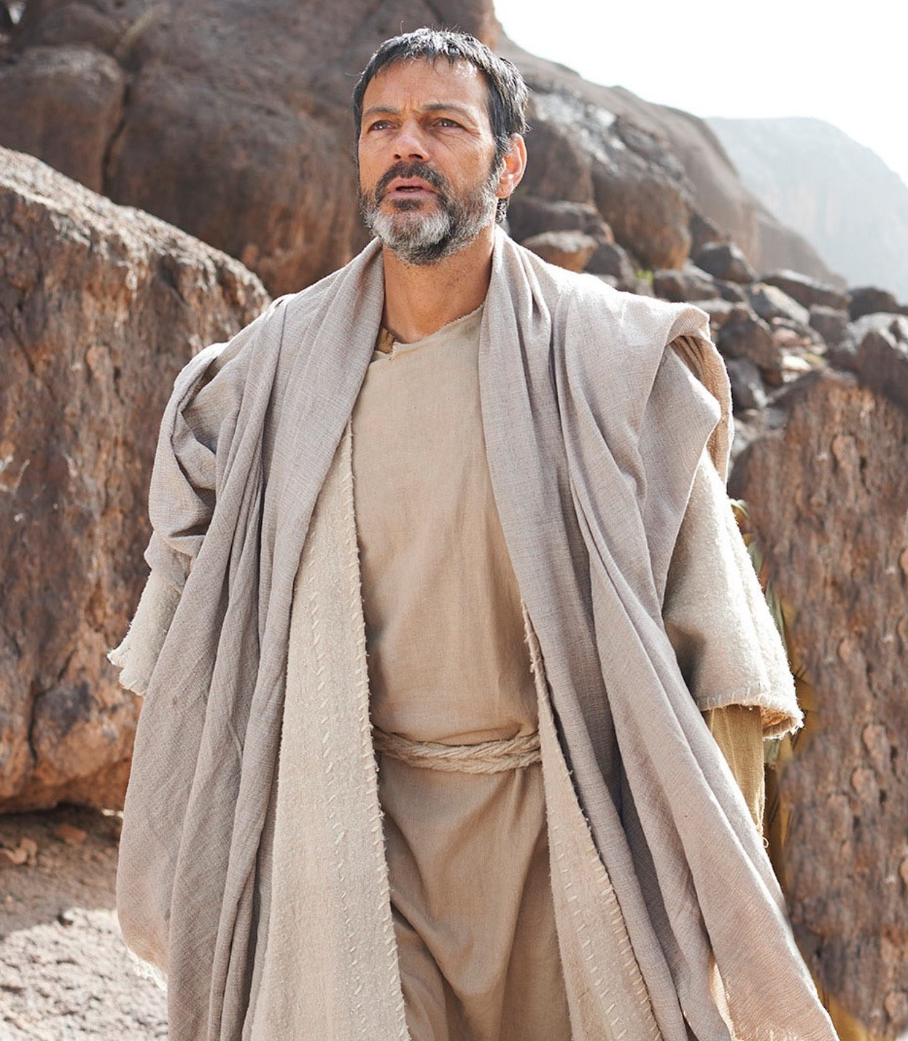
Philippians 1:1-2
Principles of a “gospel identity”

Slide 7
¹ Paul and Timothy, servants of Christ Jesus,
To all the saints in Christ Jesus at Philippi, together with the overseers and deacons:
² Grace and peace to you from God our Father and the Lord Jesus Christ.
Philippians 1:1-2
Why does Paul start out his letters like this?
Notes:
Basic formula of Paul’s greetings: Who he is, who his audience is, a reminder of what we have in Christ

Slide 8
Three principles of a gospel identity:
¹ Paul and Timothy, servants of Christ Jesus,
To all the saints in Christ Jesus at Philippi, together with the overseers and deacons:
² Grace and peace to you from God our Father and the Lord Jesus Christ.
Philippians 1:1-2

Slide 9
Three principles of a gospel identity:
We are servants / slaves of Christ
¹ Paul and Timothy, servants of Christ Jesus,
To all the saints in Christ Jesus at Philippi, together with the overseers and deacons:
² Grace and peace to you from God our Father and the Lord Jesus Christ.
Philippians 1:1-2

Slide 10
Three principles of a gospel identity:
We are servants / slaves of Christ
We are saints
¹ Paul and Timothy, servants of Christ Jesus,
To all the saints in Christ Jesus at Philippi, together with the overseers and deacons:
² Grace and peace to you from God our Father and the Lord Jesus Christ.
Philippians 1:1-2

Slide 11
Three principles of a gospel identity:
We are servants / slaves of Christ
We are saints
We are recipients of God’s grace and peace
¹ Paul and Timothy, servants of Christ Jesus,
To all the saints in Christ Jesus at Philippi, together with the overseers and deacons:
² Grace and peace to you from God our Father and the Lord Jesus Christ.
Philippians 1:1-2

Slide 12
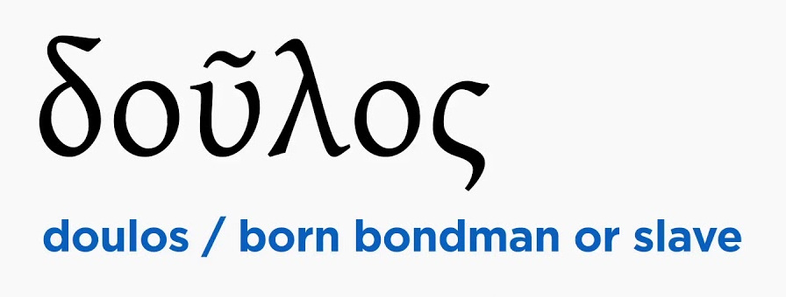
So how does God want us to think about ourselves?
We are slaves of Christ

Slide 13
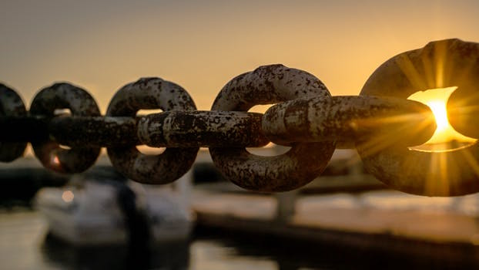
Slaves of Christ – A Conscious Choice
“You must have the same attitude that Christ Jesus had.
Though he was God, he did not think of equality with God as something to cling to.
Instead, he gave up his divine privileges; he took the humble position of a slave and was born as a human being.
When he appeared in human form, he humbled himself in obedience to God and died a criminal’s death on a cross.”
Philippians 2:5-8 (NLT)

Slide 14
Slaves of Christ – A Conscious Choice
“You must have the same attitude that Christ Jesus had.
Though he was God, he did not think of equality with God as something to cling to.
Instead, he gave up his divine privileges; he took the humble position of a slave and was born as a human being.
When he appeared in human form, he humbled himself in obedience to God and died a criminal’s death on a cross.”
Philippians 2:5-8 (NLT)
Being a slave of Christ is a choice to:
Not cling to a rightful position
Notes:
Example of a manager helping to clean

Slide 15
Slaves of Christ – A Conscious Choice
“You must have the same attitude that Christ Jesus had.
Though he was God, he did not think of equality with God as something to cling to.
Instead, he gave up his divine privileges; he took the humble position of a slave and was born as a human being.
When he appeared in human form, he humbled himself in obedience to God and died a criminal’s death on a cross.”
Philippians 2:5-8 (NLT)
Being a slave of Christ is a choice to:
Not cling to a rightful position
Give up privileges that are rightfully ours
Notes:
Example of a doctor giving up a successful career to serve patients here

Slide 16
Slaves of Christ – A Conscious Choice
Being a slave of Christ is a choice to:
Not cling to a rightful position
Give up privileges that are rightfully ours
Humble ourselves in obedience
“You must have the same attitude that Christ Jesus had.
Though he was God, he did not think of equality with God as something to cling to.
Instead, he gave up his divine privileges; he took the humble position of a slave and was born as a human being.
When he appeared in human form, he humbled himself in obedience to God and died a criminal’s death on a cross.”
Philippians 2:5-8 (NLT)
Notes:
Why does obedience require humility? If I stay in circumstances that it feels like I’m in control of, life feels manageable. If I get involved in uncomfortable situations out of obedience, I often can’t control what happens, can’t meet all the needs, etc. Language learning is an example of this!

Slide 17
Slaves of Christ – A Conscious Choice
Being a slave of Christ is a choice to:
Not cling to a rightful position
Give up privileges that are rightfully ours
Humble ourselves in obedience
Obey to the point of death!
“You must have the same attitude that Christ Jesus had.
Though he was God, he did not think of equality with God as something to cling to.
Instead, he gave up his divine privileges; he took the humble position of a slave and was born as a human being.
When he appeared in human form, he humbled himself in obedience to God and died a criminal’s death on a cross.”
Philippians 2:5-8 (NLT)
Notes:
Is this type of obedience only for Jesus? No!

Slide 18
Slaves of Christ – A Conscious Choice
“If any of you wants to be my follower, you must give up your own way, take up your cross daily, and follow me.”
Luke 9:23

Slide 19
Slaves of Christ – A Conscious Choice
How might we need to “die”?
Humbling ourselves to learn (and stay in) a new culture here
Giving up what we want for the sake of a relationship – with a spouse for example
Choosing to forgive someone in a conflict and giving up my “right” to my way
Notes:
Husbands and wives loving in spite of not feeling respect and love, respectively

Slide 20
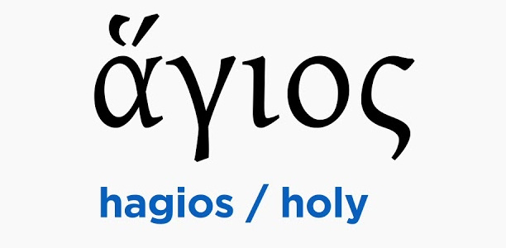
So how does God want us to think about ourselves?
We are slaves of Christ
We are saints
“To all the saints in Christ Jesus at Philippi, together with the overseers and deacons…”

Slide 21
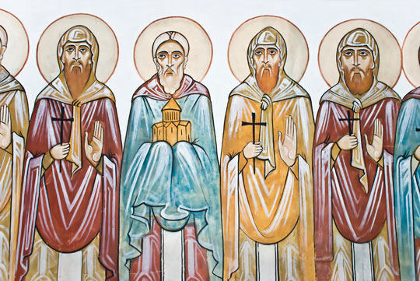
What does it mean to be a saint???

Slide 22
In the King James New Testament:
Word “hagios” appears 229 times, translated “saints” 62 times and “holy” 167 times
97 of these references are to the “Holy” Spirit
70 uses refer to holy things, holy places, holy angels, Jesus or God himself
The 62 occurrences of “saints” always refer to believers in general - never to a single person or a special class of believers

Slide 23
So why are believers referred to as “saints”?
Definition of “Hagios”:
Consecrated, devoted, sacred, holy,
set apart for a sacred use
1 Peter 2:9 “…you are a chosen race, a royal priesthood, a holy nation, a people belonging to God…”
“Saints” refers not to what we’ve done, but to who we are called to be – Our new identity as believers!

Slide 24
1 Peter 2:9 “…you are a chosen race, a royal priesthood, a holy nation, a people belonging to God…”
We have the wonderful privilege of being “God’s Chosen People”!
We are a new race – based not on ethnic identity, but on spiritual identity as the people of God
Just as the OT priests, as God’s representatives, had a different standard of behavior, so we too have a different standard

Slide 25
Examples of a different standard…
Examples from 1 Peter 2 & 3:
Citizens submitting to unjust governments
Slaves submitting to unjust masters
Wives submitting to unbelieving or unjust husbands
Husbands considering and honoring their wives
Repaying evil with blessing
Repay evil
As God’s chosen people – his saints – this is what we’re called to!

Slide 26
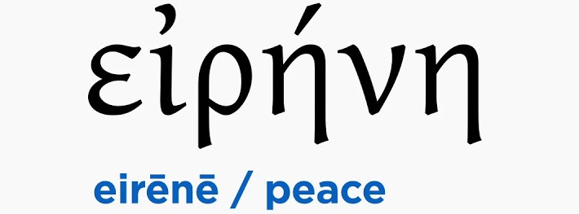
So how does God want us to think about ourselves?
We are slaves of Christ
We are saints
We are recipients of God’s grace and peace
“Grace and peace to you from God our Father and the Lord Jesus Christ.”

Slide 27
What does Grace mean?
Charis (from verb meaning “to rejoice”):
That which causes joy/pleasure for the receiver
Unearned/Unmerited favor
Unearned spiritual life given to us through Jesus
God’s grace includes the idea of every favor, blessing or good given to us by him.
Notes:
Human example: Giving food to a beggar who you know has just stolen your child’s bike!

Slide 28
What does Peace mean?
_
_
Eirene:
Freedom from conflict
Peace of mind, tranquility, wholeness, safety, soundness, well being
Arising from reconciliation with God and a sense of a divine favor
Made possible by his grace

Slide 29
So how does God want us to think about ourselves?
We are slaves of Christ
We are saints
We are recipients of God’s grace and peace
This is a Gospel Identity!

Slide 30
What’s your identity?
What do you tell people about who/what you are?
What in your life, if you lost it, would be devastating to you?
Do you feel you are above those around you?
Do you feel you are below those around you?

Slide 31
By default, the society around us “assigns” us our identity based on our race, passport country, education, talents, etc.
Can we change that?
So what can we change?
We can change how we see ourselves!
(Our Internal Identity)
Notes:
For example,
In the US, one of the first questions people tend to ask when they meet someone is, “What do you do?”
In Jordan, one of the first questions people tend to ask when they meet someone is, “What family are you from?”
Discuss in pairs or threes

Slide 32
God has called all believers to have a gospel identity!
But how do we change our identity? How do we change how we see ourselves?

Slide 33
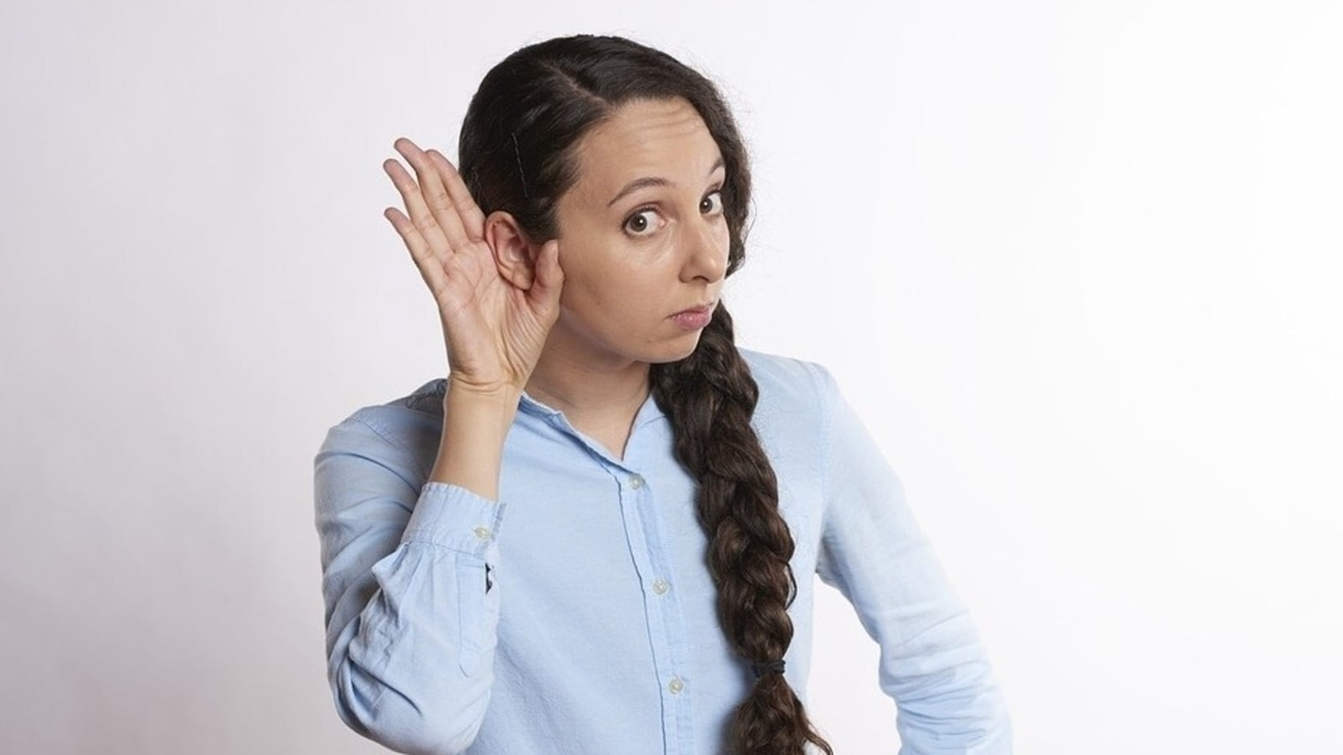
Does simply hearing these truths mean you will be able to change how you think about yourself?
What will it take?
Notes:
For example,
In the US, one of the first questions people tend to ask when they meet someone is, “What do you do?”
In Jordan, one of the first questions people tend to ask when they meet someone is, “What family are you from?”
Discuss in pairs or threes

Slide 34
Changing our internal identity takes work, practice, new routines & habits
Notes:
For example,
In the US, one of the first questions people tend to ask when they meet someone is, “What do you do?”
In Jordan, one of the first questions people tend to ask when they meet someone is, “What family are you from?”
Discuss in pairs or threes

Slide 35
I am a Recipient of God’s Grace
Because Jesus died for me, God gives me his favor, blessing and spiritual life instead of what I deserve.
Notes:
For example,
In the US, one of the first questions people tend to ask when they meet someone is, “What do you do?”
In Jordan, one of the first questions people tend to ask when they meet someone is, “What family are you from?”
Discuss in pairs or threes

Slide 36
2. I am a Recipient of God’s Peace
Because of God’s grace, I can live today in peace and safety, enjoying his presence and favor on my life.
Notes:
For example,
In the US, one of the first questions people tend to ask when they meet someone is, “What do you do?”
In Jordan, one of the first questions people tend to ask when they meet someone is, “What family are you from?”
Discuss in pairs or threes

Slide 37
3. I am a Saint
I am one of God’s chosen people. I can live today as one who belongs to him and has been set apart for his special purposes.
Notes:
For example,
In the US, one of the first questions people tend to ask when they meet someone is, “What do you do?”
In Jordan, one of the first questions people tend to ask when they meet someone is, “What family are you from?”
Discuss in pairs or threes

Slide 38
4. I am God’s Slave
Because of all that God has done for me, I choose to live today in humble and obedient submission to him, giving up positions and privileges that I would otherwise cling to.
Notes:
For example,
In the US, one of the first questions people tend to ask when they meet someone is, “What do you do?”
In Jordan, one of the first questions people tend to ask when they meet someone is, “What family are you from?”
Discuss in pairs or threes

Slide 39
What’s your identity?
By God’s grace (even though we don’t deserve his help!), let’s move in the direction of a gospel identity!

Slide 41
NT Preaching link at BibleStudyDownloads.org
Get this presentation for free!
Notes:
NT Preaching (np)

